Slide 1
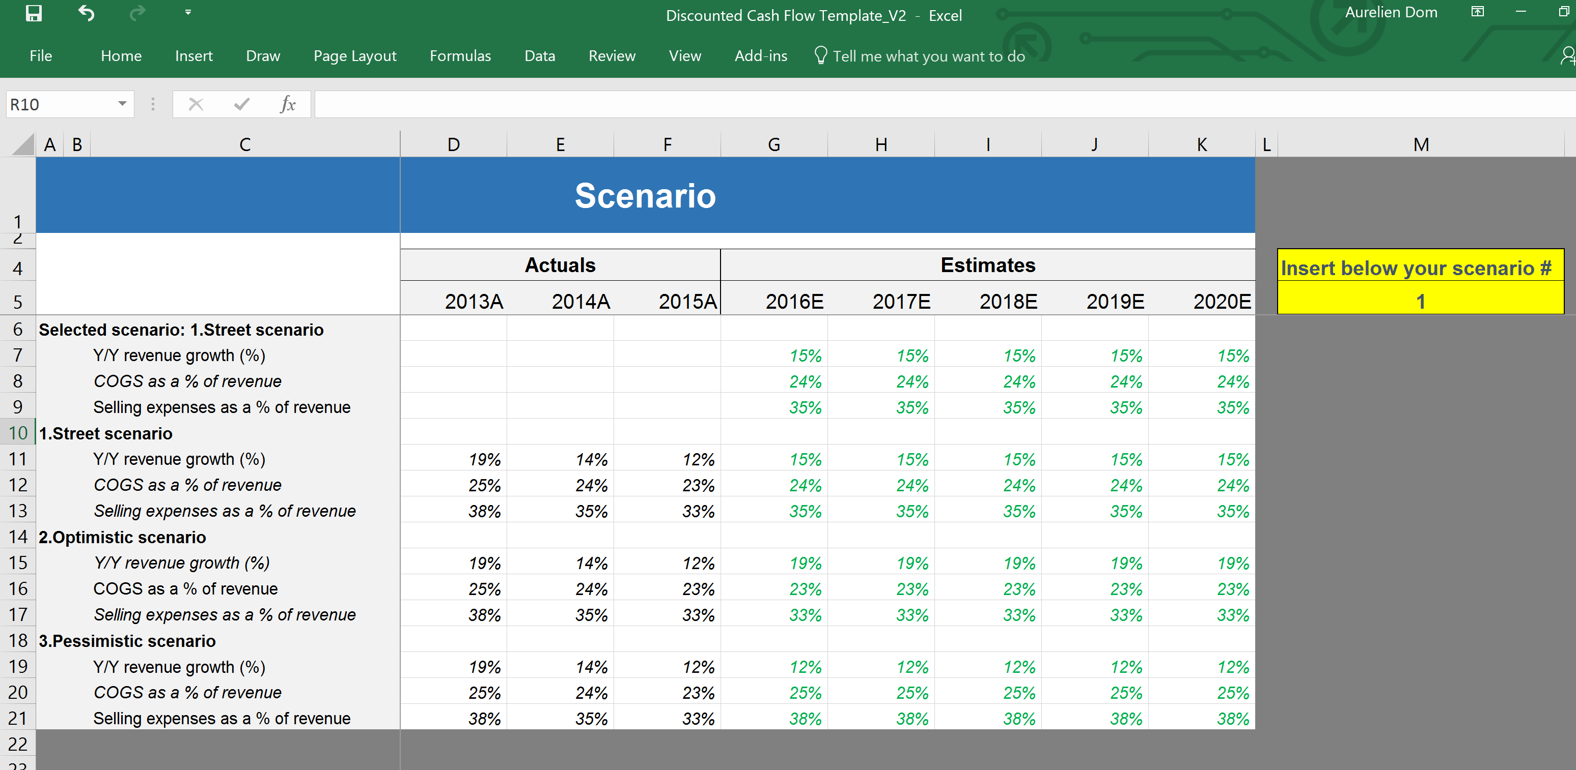
Financial Model linking the 3 Financial Statements - Tutorial
Confidential
By Former Deloitte Management Consultants

Slide 2
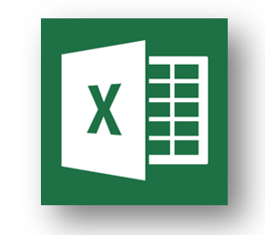
Step 1 - Use our excel Income Statement template and adjust when necessary the actual years, projected years and line items
Adjust the actual and projected years. Taking 3 historical years and 5 projected years is usually a good trade-off between being comprehensive and effective
The line items in percentage have been added to facilitate the projection that we will do later on
Add or remove line items depending on your needs. You should only have line items that are useful for what you want to achieve

Slide 3
Step 2 - Use our excel Cash Flow statement and adjust when necessary the actual years, projected years and line items
Use the same years, format and columns as the income statement
Add or remove line items depending on your needs. You should only have line items that are useful for what you want to achieve

Slide 4
Step 3 - Use our excel Balance Sheet statement and adjust when necessary the actual years, projected years and line items
Use the same years, format and columns as the income statement
Add or remove line items depending on your needs. You should only have line items that are useful for what you want to achieve

Slide 5
Step 4 - Create a map of the different excel sheets of your workbook
Quarterly and/or annual reports
Income statement
Cash flow
Balance sheet
Scenario with assumptions

Slide 6
Step 5 - Fill in the historical years for the 3 financial statements
Generic tips
Use a blue font for the hardcoded cells
Use a black font for the calculated cells
Use green font for your assumptions
Income statement
Fill in the “$” line items using the company’s quarterly or/and yearly reports
Fill the “%” line items using the formulas in our “Example” excels sheets (If you added or removed line items, make sure the formulas stay relevant
Cash flow
Link the line items “Net Income”, “D&A” and “Dividend paid” with the relevant items within the Income statement
Fill in the remaining line items using the company’s quarterly or/and yearly reports
Balance sheet
Fill in every line items of the first historical year using the company’s quarterly or/and yearly reports
Fill in every line items of the other historical years by linking them with the relevant line items from the cash flow statement

Slide 7
Step 6 - Identify if required several scenarios including different assumptions using our excel sheet “scenario”
Changing the number in the yellow box, will update the “selected scenario” which will update the 3 financial statements

Slide 8
Step 7 - Fill in the projected years of the income statement with the assumptions included in the excel sheet “Scenario”
Important Note
Sometimes you may want to have some assumptions in your income statement sheet and not in your scenario sheet. If you do, make sure that they are in green. Besides be aware that when you will change of scenario in your scenario sheet, these assumptions will stay identical

Slide 9
Step 8 - Fill in the projected years of the cash flow statement

Slide 10
Step 9 - The Balance sheet projected year should be automatically updated based on the Cash flow statement. Just ensure that Asset equals Liabilities + Equity
If Asset doesn’t equal Liability + Equity, check that:
Every line items of the Balance sheet is linked to the relevant line item of the Cash flow statement
Each cash flow statement line items is used once
Ensure that the “sign” linking the Balance sheet with the Cash flow statement is the right correct using your common sence or checking the formulas we used in our Excel examples

Slide 11
Step 10 - Double check that your financial statements automatically update when you change of scenario and make sure the financial statements are linked properly
From Income statement…
…to Cash flow statement
Revenue
Net income adjusted
Cost of goods sold
Depreciation and amortization
Gross profit
Deferred income taxes
Operating expenses
Changes in accounts receivable
Operating activities
EBITDA
Changes in inventory
Depreciation and amortization
Changes in accounts payable
EBIT
Changes in accrued liabilities
Interest
CAPEX
Investing activities
Income tax expense
Other investing activities
Net Income (Adjusted)
Debt
Net Income
Dividends paid
Financing activities
Dividend payout
Equity Issuances (buybacks)
Net income after distribution
Total change in cash

Slide 12
Step 10 - Double check that your financial statements automatically update when you change of scenario and make sure the financial statements are linked properly
From Cash flow statement…
…to Balance Sheet
Net income adjusted
Cash
Depreciation and amortization
Receivables, net
Deferred income taxes
Inventories
Asset
Operating activities
Changes in accounts receivable
Property, plant and equipment, net
Changes in inventory
Other long-term assets
Changes in accounts payable
Accounts payable
Changes in accrued liabilities
Accrued liabilities
CAPEX
Liabilities
Investing activities
Debt
Other investing activities
Debt
Deferred income taxes
Dividends paid
Equity
Financing activities
Equity
Equity Issuances (buybacks)
Retained earnings
Total change in cash

Slide 13









Interested in more Business & Consulting Toolkits? Our ex-McKinsey, Deloitte & BCG Consultants created 10 Toolkits including practical Frameworks, Tools & Templates
1.Corporate & Business Strategy Toolkit
2.Management Consulting Toolkit
3.Change Management Toolkit
4.Project Management Toolkit
5.Sales, Marketing & Communication Toolkit
Visit Website
Visit Website
Visit Website
Visit Website
Visit Website
6.Finance and Mergers & Acquisitions Toolkit
7.Digital Transformation Toolkit
8.Operations & Supply Chain Toolkit
9.Leadership Skills Toolkit
10.Legal Toolkit
Visit Website
Visit Website
Visit Website
Visit Website
Visit Website

Slide 14

Interested in multiple Business & Consulting Toolkits? Get access to all our Toolkits for half the price with the Gold Business & Consulting Package
Gold Business & Consulting Package
Learn More
www.slidebooks.com

Slide 15



Need more help? Hire one of our Management Consultants for $4,000 a day
Learn More

Slide 16

Thanks for your attention!
www.slidebooks.com

